Slide 1
What Networks Could Be
Different Approaches to Network Analyses
Alvin Zhou, 11/23/2021

Slide 2
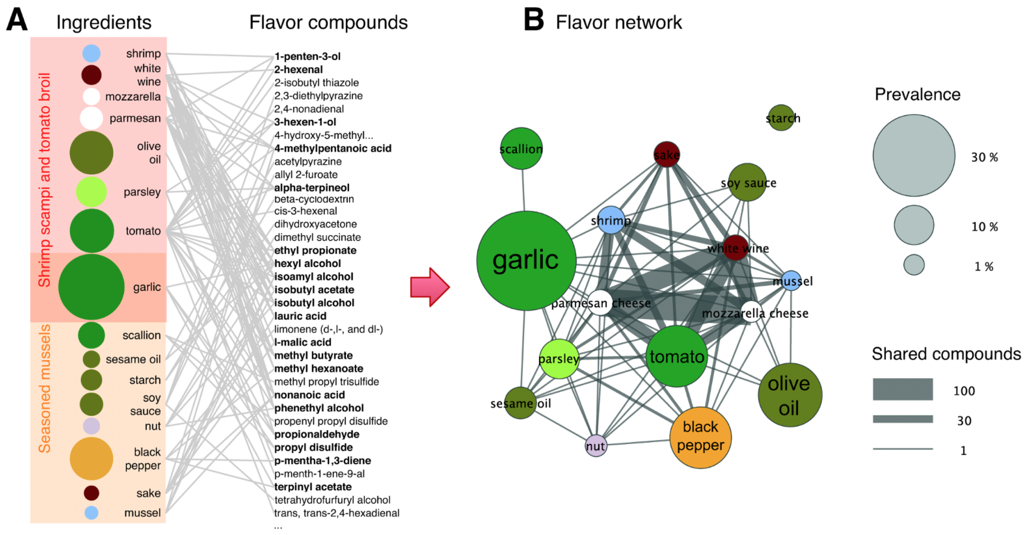
Ahn et al. (2011)
Notes:
What data they have? What’s their question?
(A) The ingredients contained in two recipes (left column), together with the flavor compounds that are known to be present in the ingredients (right column). Each flavor compound is linked to the ingredients that contain it, forming a bipartite network. Some compounds (shown in boldface) are shared by multiple ingredients. (B) If we project the ingredient-compound bipartite network into the ingredient space, we obtain the flavor network, whose nodes are ingredients, linked if they share at least one flavor compound. The thickness of links represents the number of flavor compounds two ingredients share and the size of each circle corresponds to the prevalence of the ingredients in recipes.

Slide 3
Ahn et al. (2011)
Notes:
What’s node, what’s tie, and directed? Weighted? What does the visualization tell us?
(A) The ingredients contained in two recipes (left column), together with the flavor compounds that are known to be present in the ingredients (right column). Each flavor compound is linked to the ingredients that contain it, forming a bipartite network. Some compounds (shown in boldface) are shared by multiple ingredients. (B) If we project the ingredient-compound bipartite network into the ingredient space, we obtain the flavor network, whose nodes are ingredients, linked if they share at least one flavor compound. The thickness of links represents the number of flavor compounds two ingredients share and the size of each circle corresponds to the prevalence of the ingredients in recipes.

Slide 4
Node: ingredient
Tie: shared flavor compound
What else could be the tie?
Ahn et al. (2011)
Notes:
If we keep ingredients as the node, what else could be the tie?
(A) The ingredients contained in two recipes (left column), together with the flavor compounds that are known to be present in the ingredients (right column). Each flavor compound is linked to the ingredients that contain it, forming a bipartite network. Some compounds (shown in boldface) are shared by multiple ingredients. (B) If we project the ingredient-compound bipartite network into the ingredient space, we obtain the flavor network, whose nodes are ingredients, linked if they share at least one flavor compound. The thickness of links represents the number of flavor compounds two ingredients share and the size of each circle corresponds to the prevalence of the ingredients in recipes.

Slide 5
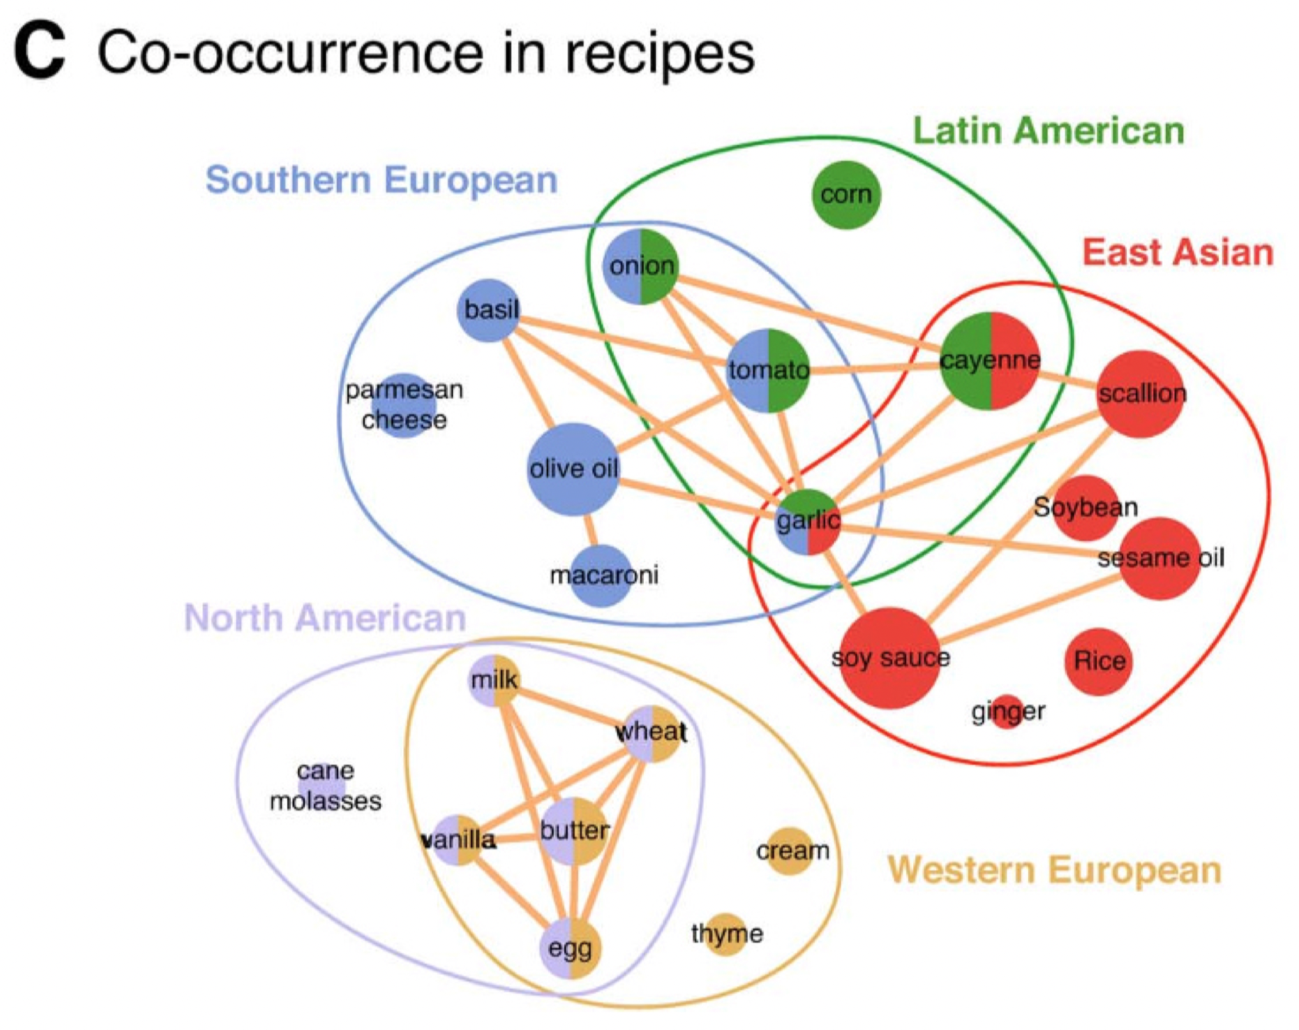
Ahn et al. (2011)

Slide 6
Node: ingredient
Tie: co-occurence
Ahn et al. (2011)

Slide 7
What other kinds of networks could be constructed from the data?
Ahn et al. (2011)
Notes:
For example, node as cuisines (e.g., east asian / latin american), tie as the number of shard ingredients.

Slide 8
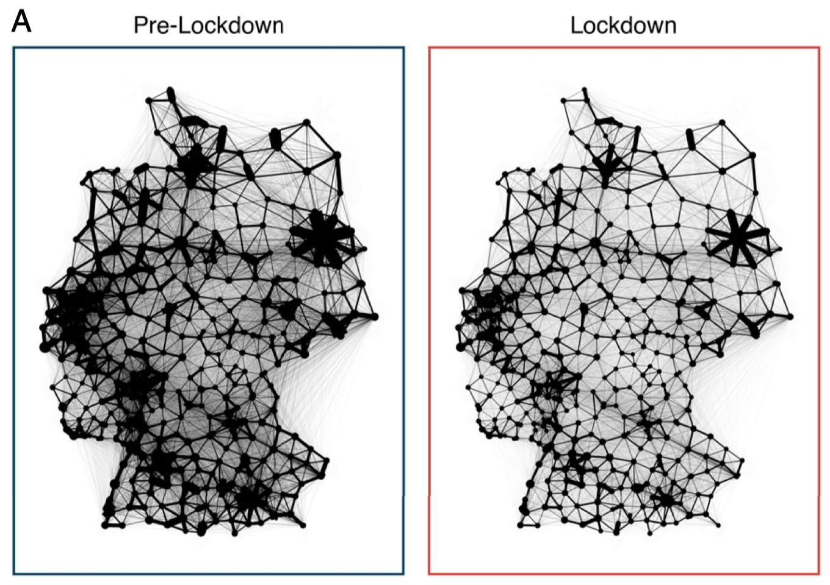
Schlosser et al. (2020)
Notes:
What data they have? What’s their question?
The edge weights correspond to the average daily ﬂow along the edge (between counties) during this week
During lockdown, less dense
(A) Depiction of the networks. Line widths indicate the average number of daily trips along each connection. During lockdown, there are fewer trips in total, fewer unique edges, and fewer long-distance connections.

Slide 9
Schlosser et al. (2020)
Notes:
Is the loss of mobility universally the same across Germany?
Edge weights of the prelockdown network were rescaled such that it is structurally similar to the prelockdown network (as having the same total number of trips as the lockdown network)
The loss of density during lockdown cannot be explained by a global, uniform reduction of mobility alone.
(A) Depiction of the networks. Line widths indicate the average number of daily trips along each connection. During lockdown, there are fewer trips in total, fewer unique edges, and fewer long-distance connections.

Slide 10
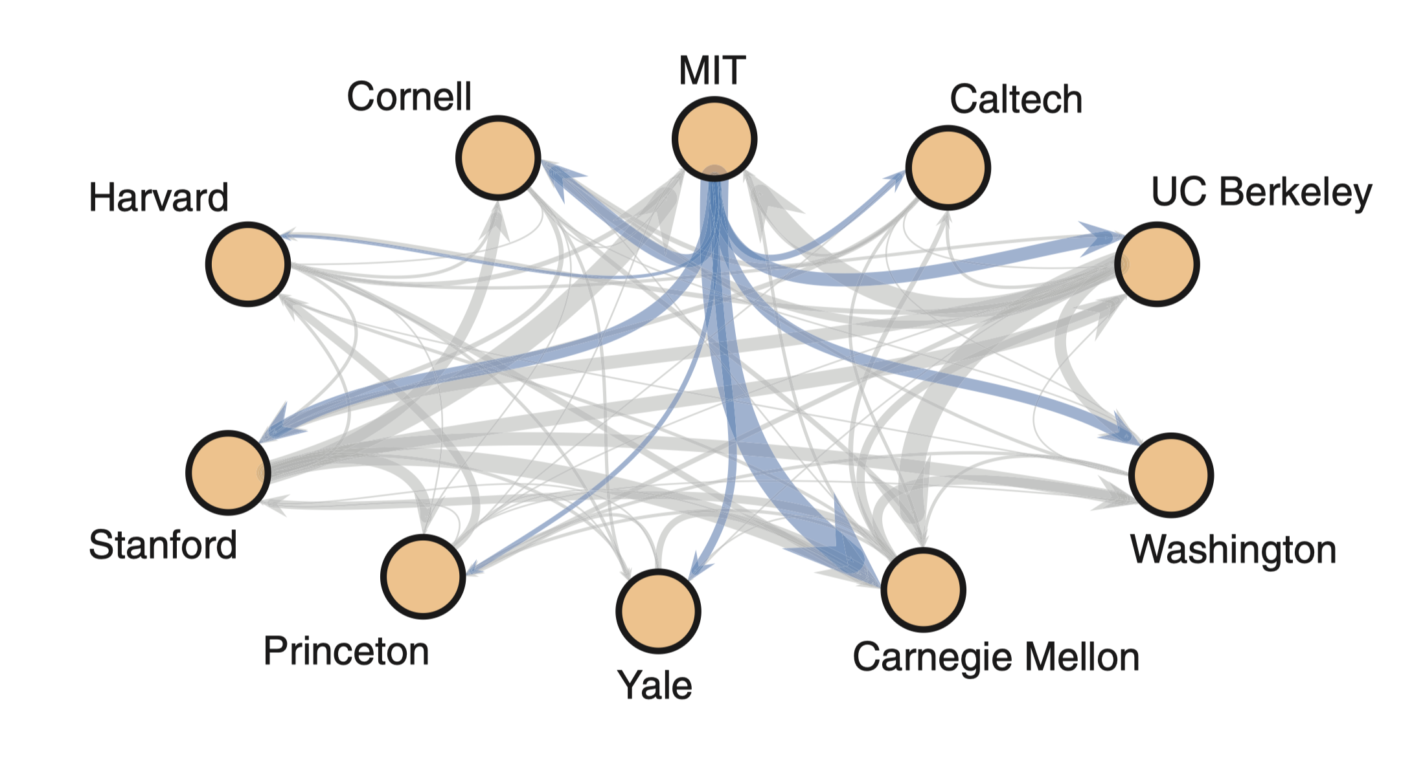
Clauset et al. (2015)
Notes:
What data they have? What’s their question?
Placements for 267 computer science faculty among 10 universities, with placements from one particular university highlighted.
female graduates generally place worse than male graduates from the same institution

Slide 11
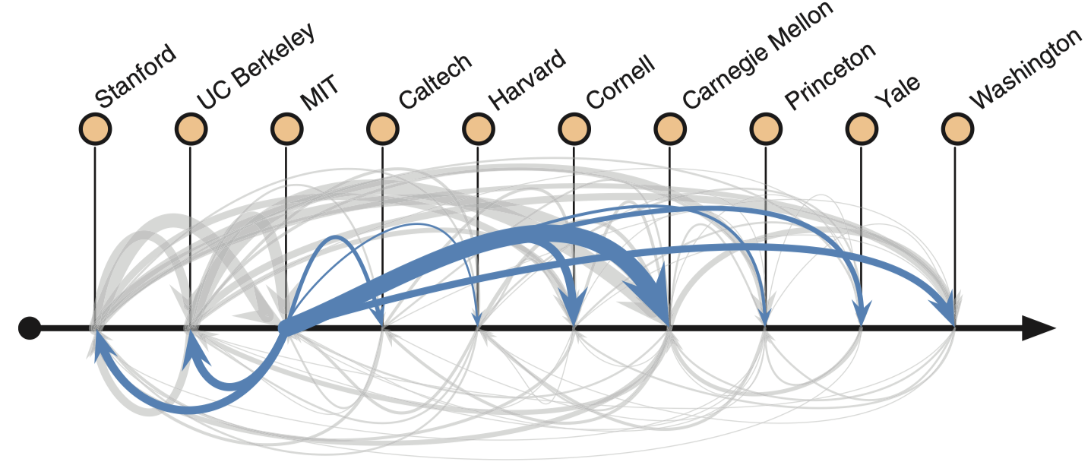
Clauset et al. (2015)
Notes:
What does this figure tell us, that something that is not shown in the previous figure?
Ranked from left to right from the most prestigeous to the least

Slide 12
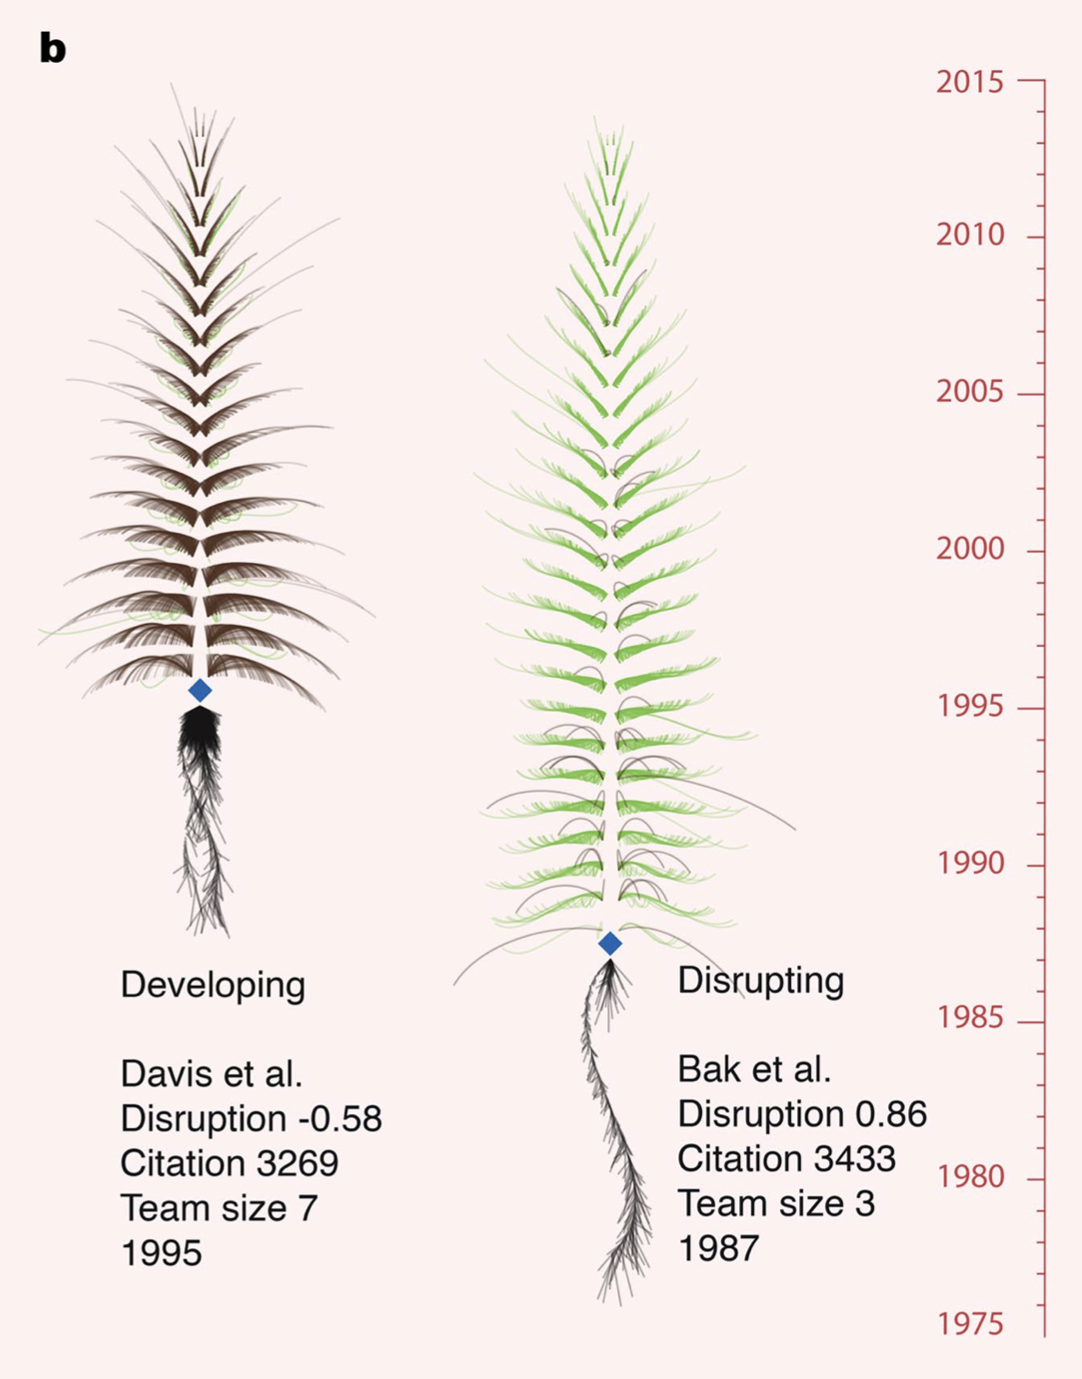
Wu et al. (2019)
Notes:
‘Roots’ are references and citations to them, with depth scaled to their publication date, ‘branches’ on the tree are citing articles, with height scaled to publication date and length scaled to the number of future citations.
Branches curve downward (brown) if citing articles also cite the focal paper’s references, and
upward (green) if they ignore them.

Slide 13
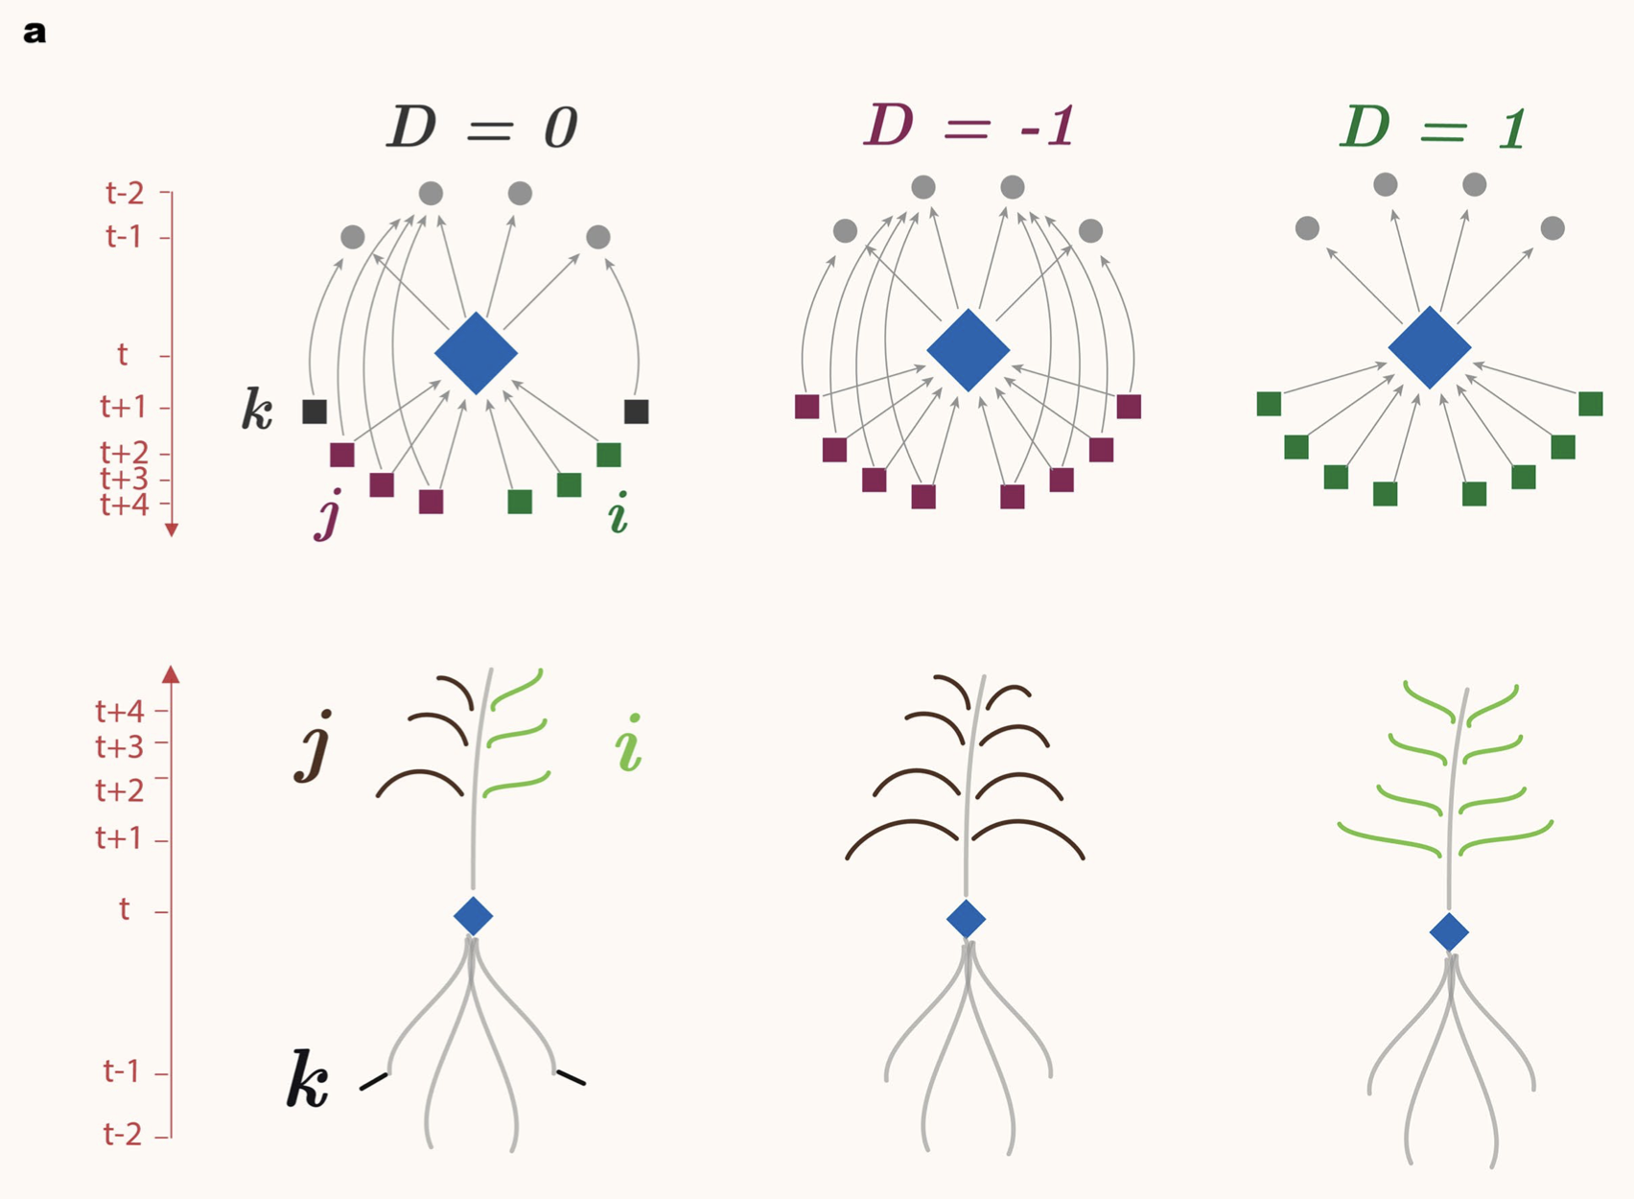
Wu et al. (2019)
Notes:
‘Roots’ are references and citations to them, with depth scaled to their publication date, ‘branches’ on the tree are citing articles, with height scaled to publication date and length scaled to the number of future citations.
Branches curve downward (brown) if citing articles also cite the focal paper’s references, and
upward (green) if they ignore them.

Slide 14
Wu et al. (2019)
Notes:
‘Roots’ are references and citations to them, with depth scaled to their publication date, ‘branches’ on the tree are citing articles, with height scaled to publication date and length scaled to the number of future citations.
Branches curve downward (brown) if citing articles also cite the focal paper’s references, and
upward (green) if they ignore them.

Slide 15
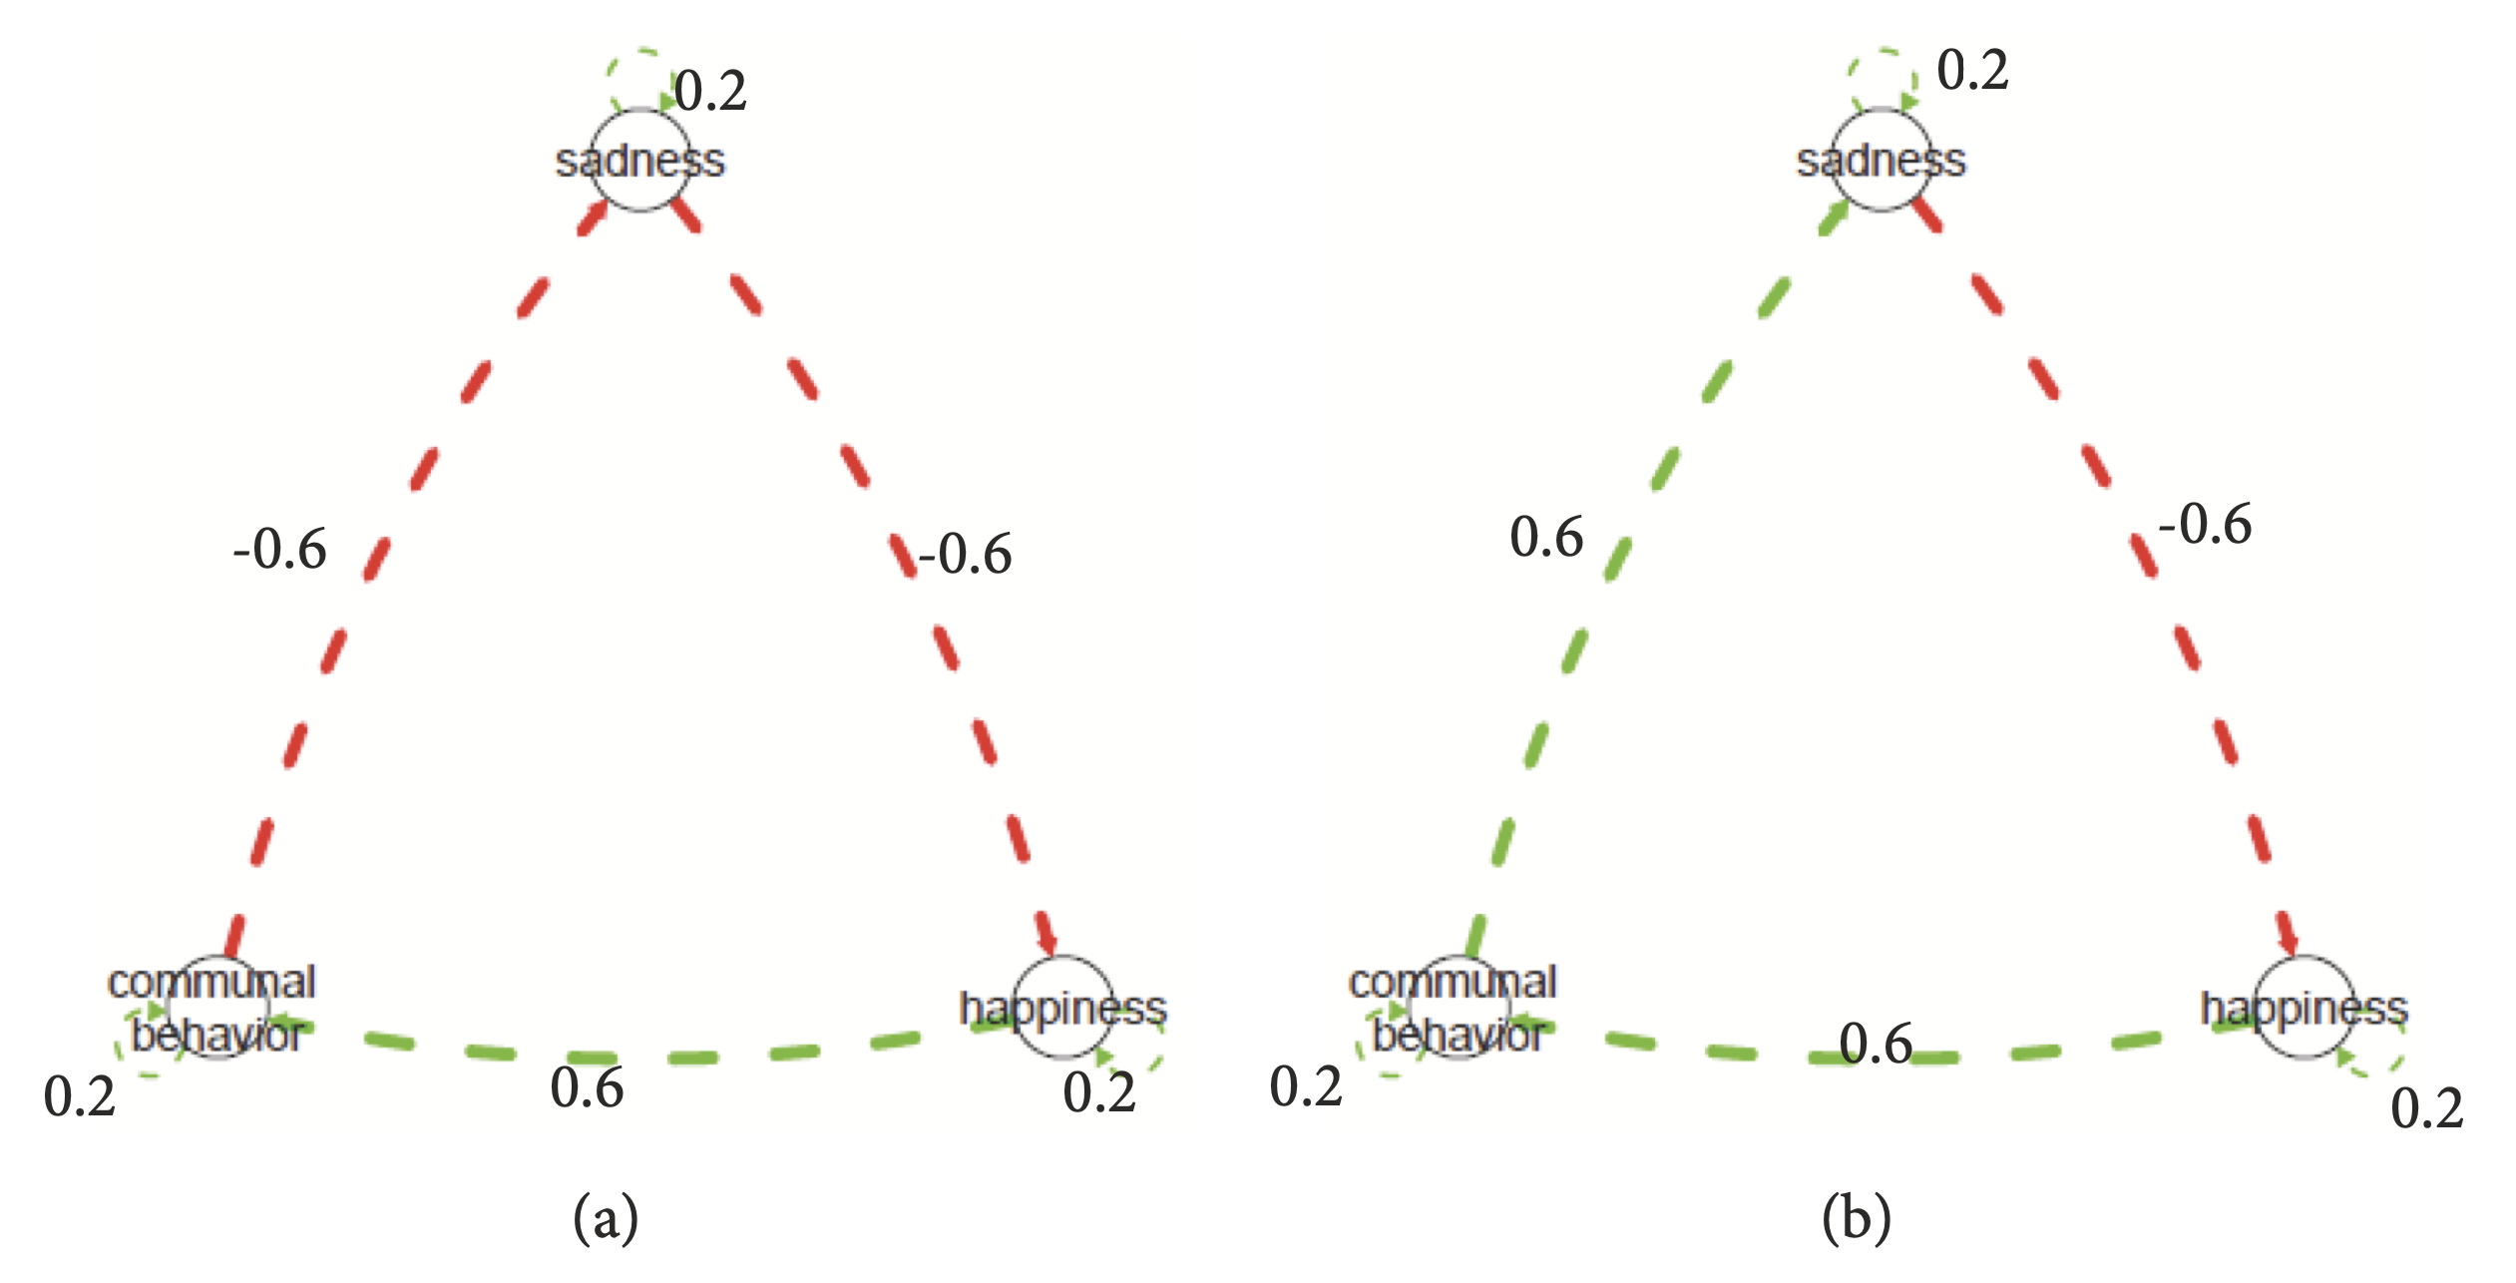
Yang et al. (2018)
Notes:
Not resilient: In Individual A’s network (Figure 1(a)), higher sadness leads to lower happiness (a temporal relation where sadness influences subsequent happiness at -0.6), lower happiness leads to lower social engagement (a temporal relation where happiness influences subsequent communal behavior at +0.6), and lower social engagement leads to higher sadness (a temporal relation where communal behavior influences subsequent sadness at -0.6).
Hence the three temporal relations together form a positive feedback loop, a structure that sustains changes in sadness.
Resilient: The overall effect of this cyclic structure is negative (-0.6 ∗ 0.6 ∗ 0.6 = -0.216); hence the three temporal relations together form a negative feedback loop. Here, the structure of the relations facilitates regulation of sadness.

Slide 16
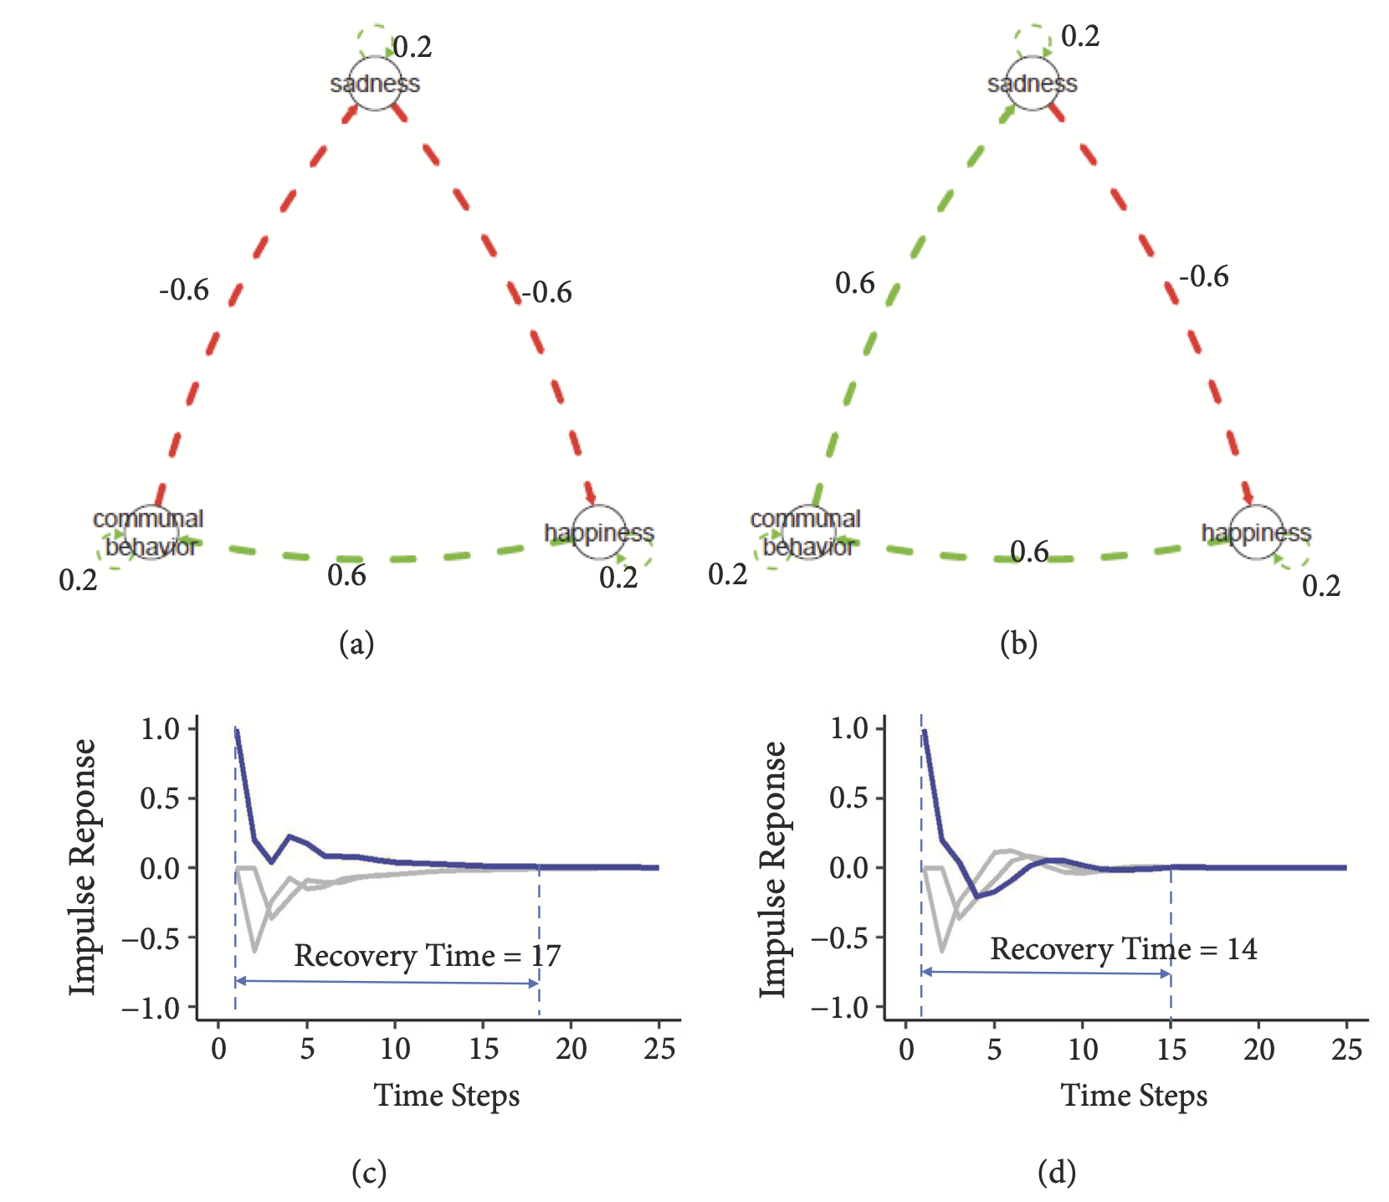
Yang et al. (2018)
Notes:
Not resilient: In Individual A’s network (Figure 1(a)), higher sadness leads to lower happiness (a temporal relation where sadness influences subsequent happiness at -0.6), lower happiness leads to lower social engagement (a temporal relation where happiness influences subsequent communal behavior at +0.6), and lower social engagement leads to higher sadness (a temporal relation where communal behavior influences subsequent sadness at -0.6).
Hence the three temporal relations together form a positive feedback loop, a structure that sustains changes in sadness.
Resilient: The overall effect of this cyclic structure is negative (-0.6 ∗ 0.6 ∗ 0.6 = -0.216); hence the three temporal relations together form a negative feedback loop. Here, the structure of the relations facilitates regulation of sadness.

Slide 17
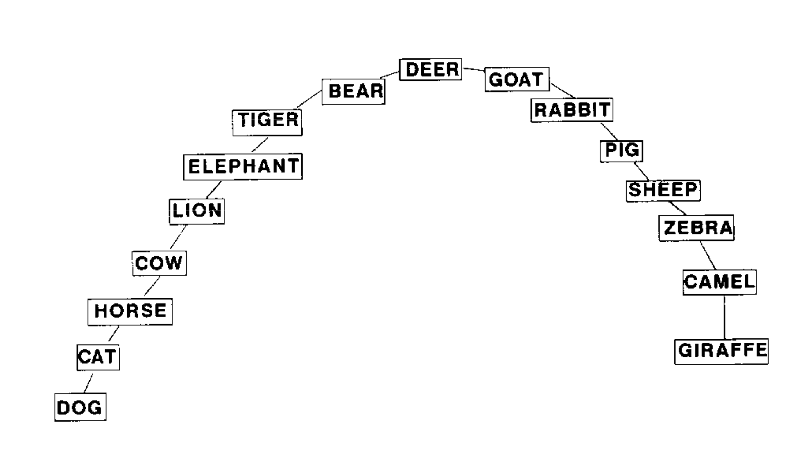
Semantic Network
Words as nodes
Ties as ?
Paulsen et al. (1996)
Notes:
Schizophrenia
Animal Fluency Test as part of the comprehensive neuropsychological evaluation
Subjects were asked to name as many animals as they could within 60 s. The semantic space analysis was performed on 16 target words (bear, camel, cat, cow, deer, dog, elephant, giraffe, goat, horse, lion, pig, rabbit, sheep, tiger, and zebra) that were among the 25 most frequent responses for the subjects and could be categorized into two possible dimensions (large-small, domestic-wild).
Pathfinder (PF) analysis

Slide 18
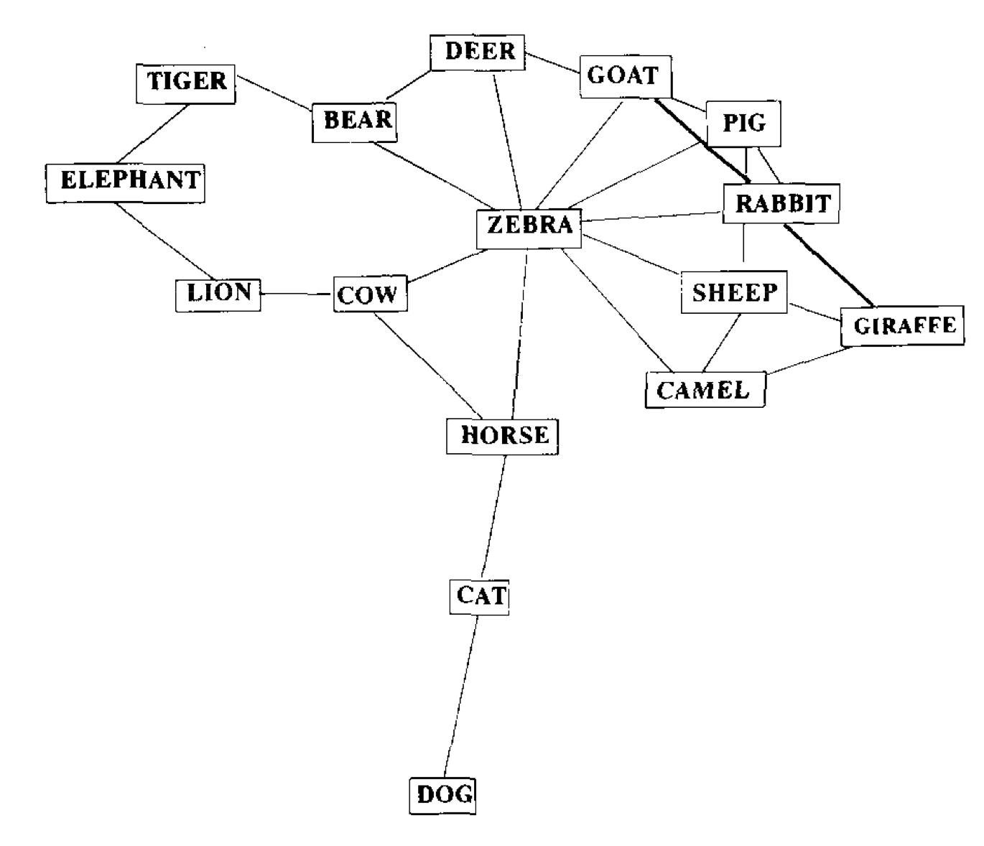
Paulsen et al. (1996)
Notes:
Schizophrenia
Animal Fluency Test as part of the comprehensive neuropsychological evaluation
Subjects were asked to name as many animals as they could within 60 s. The semantic space analysis was performed on 16 target words (bear, camel, cat, cow, deer, dog, elephant, giraffe, goat, horse, lion, pig, rabbit, sheep, tiger, and zebra) that were among the 25 most frequent responses for the subjects and could be categorized into two possible dimensions (large-small, domestic-wild).
Pathfinder (PF) analysis

Slide 19
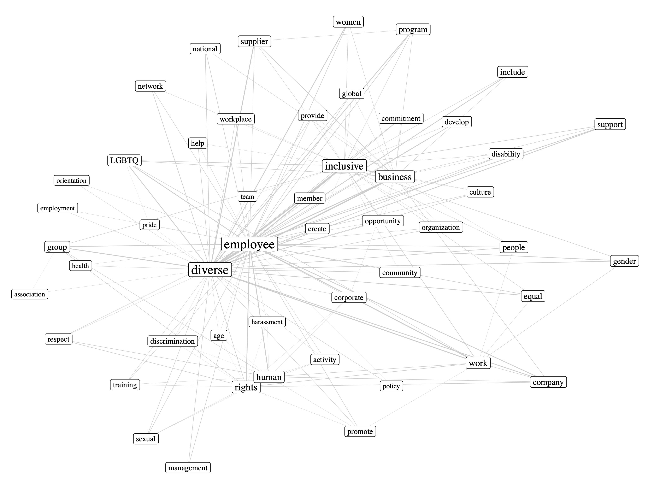
Semantic Network
Words as nodes
Ties as ?
Zhou (2019)

Slide 20
Brainstorm Time
What Networks Could Be?
Pick a topic
Think of a network
What’s the node? What’s the tie?
Node size/color? Tie width/color?
What will it tell us?

Slide 21
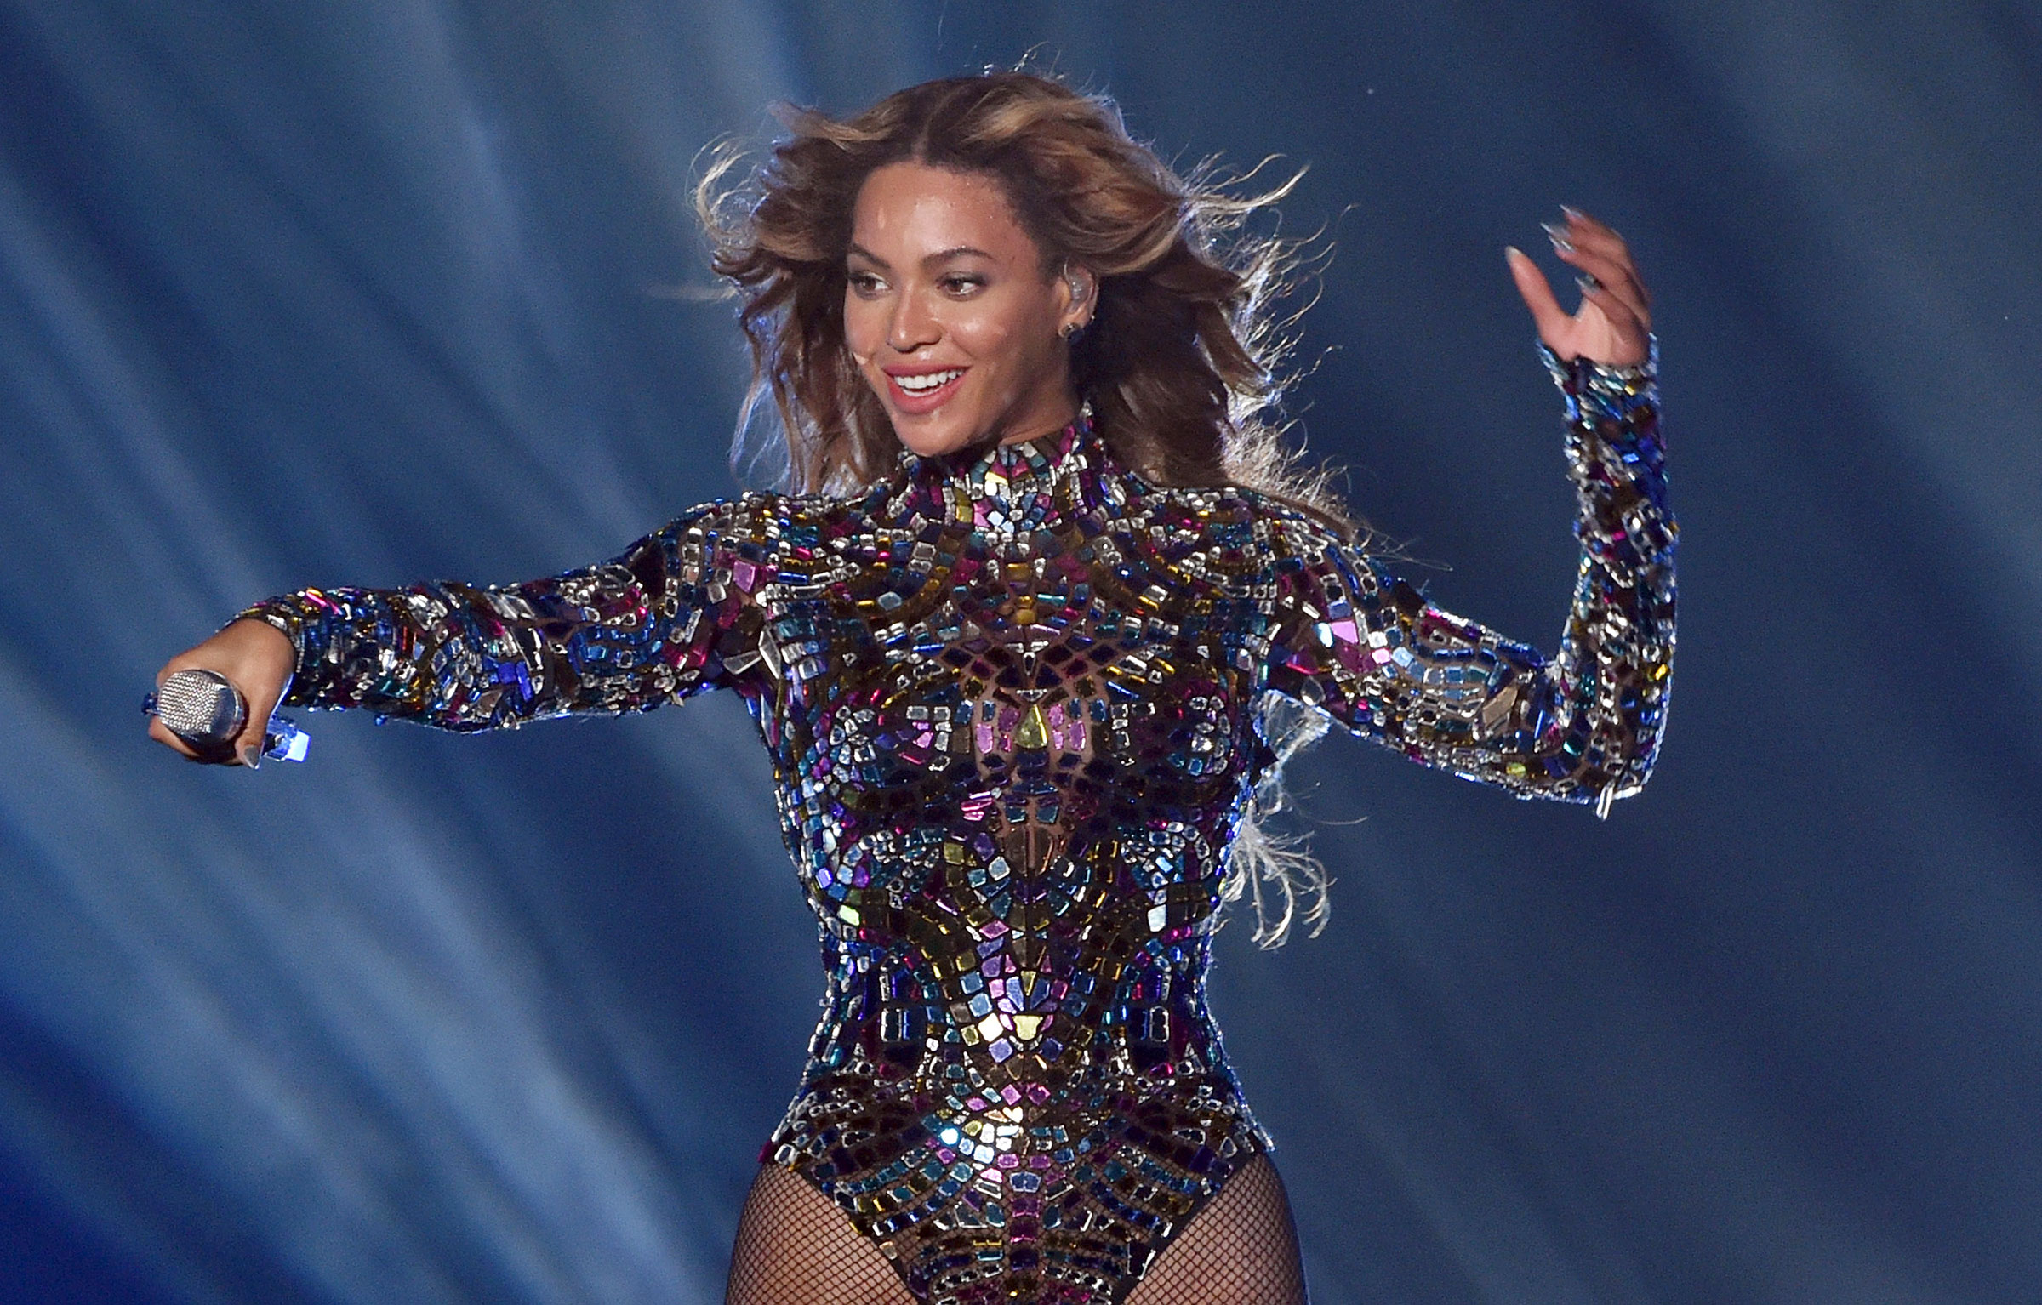
Pick a topic
Think of a network
What’s the node? What’s the tie?
Node size/color? Tie width/color?
What will it tell us?

Slide 22
Brainstorm Time
What Networks Could Be?
Pick a topic
Think of a network
What’s the node? What’s the tie?
Node size/color? Tie width/color?
What will it tell us?

Slide 23
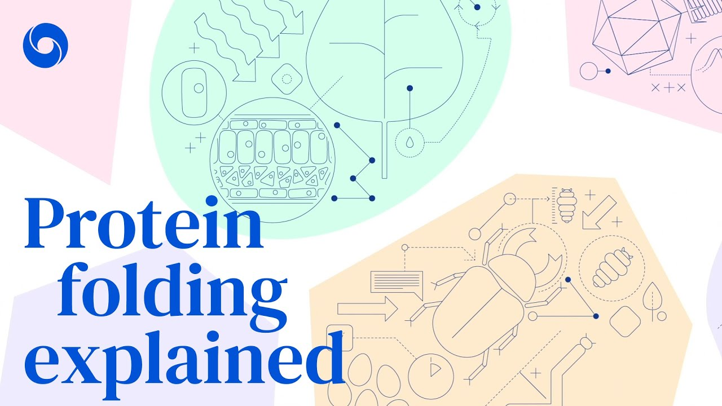

Slide 24
Networks and Machine Learning
Predict Protein Folding with Networks
Twenty amino acids:
ARNDCQEGHILKMFPSTWYV

Slide 25
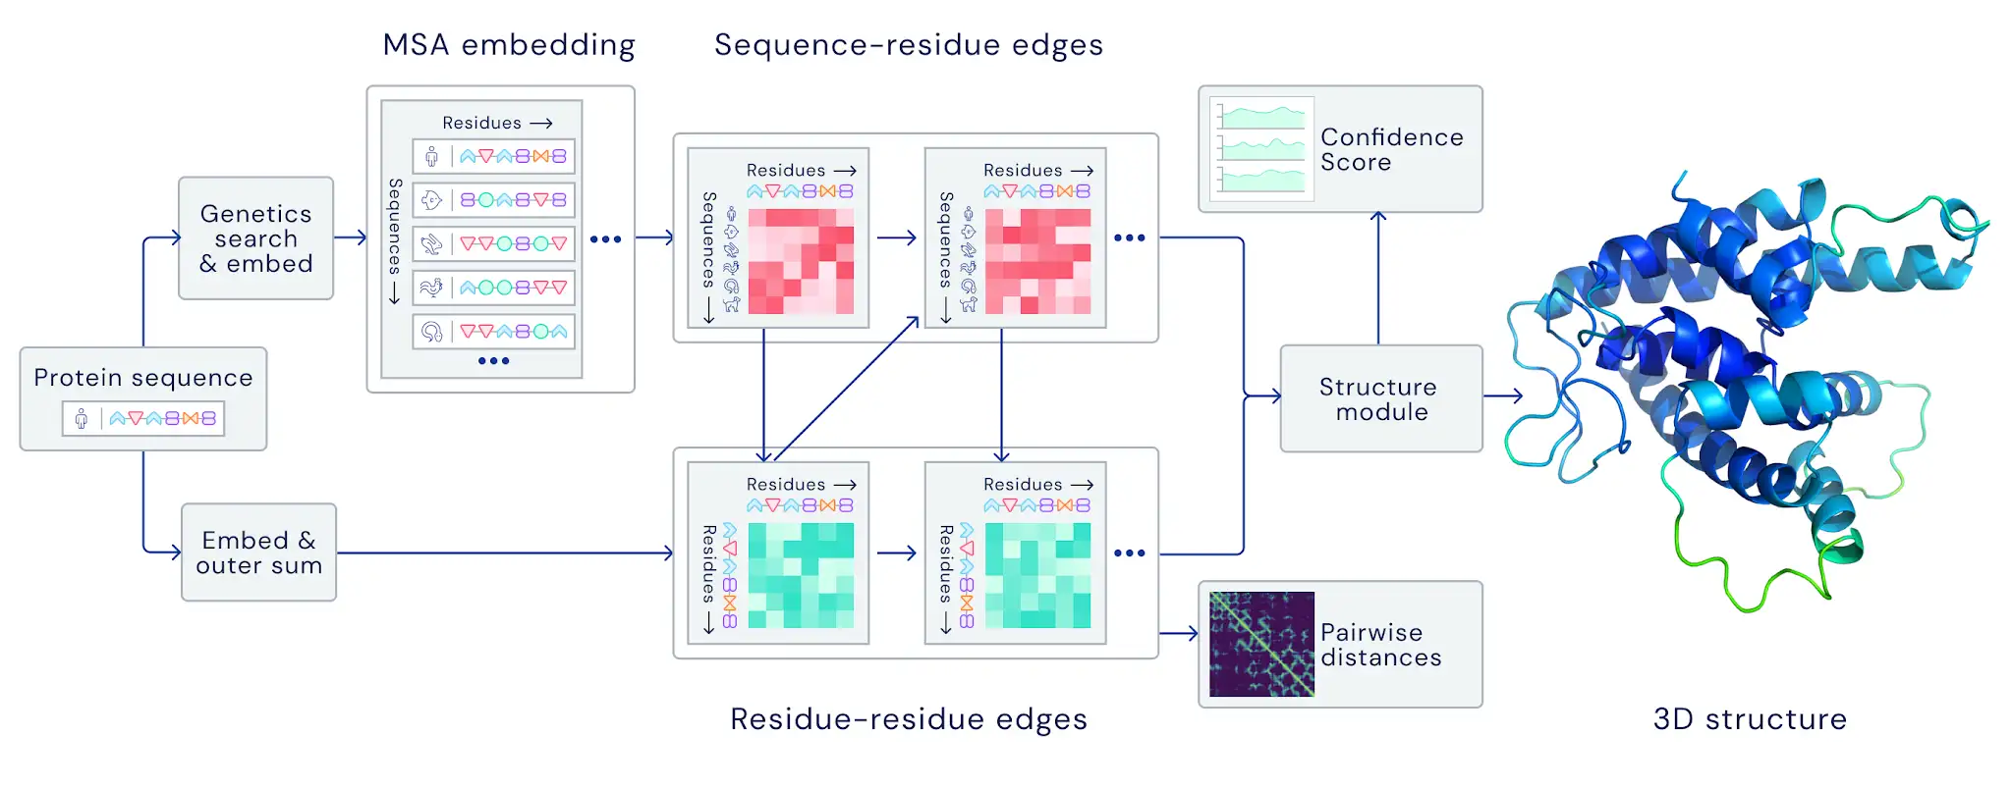

Slide 27
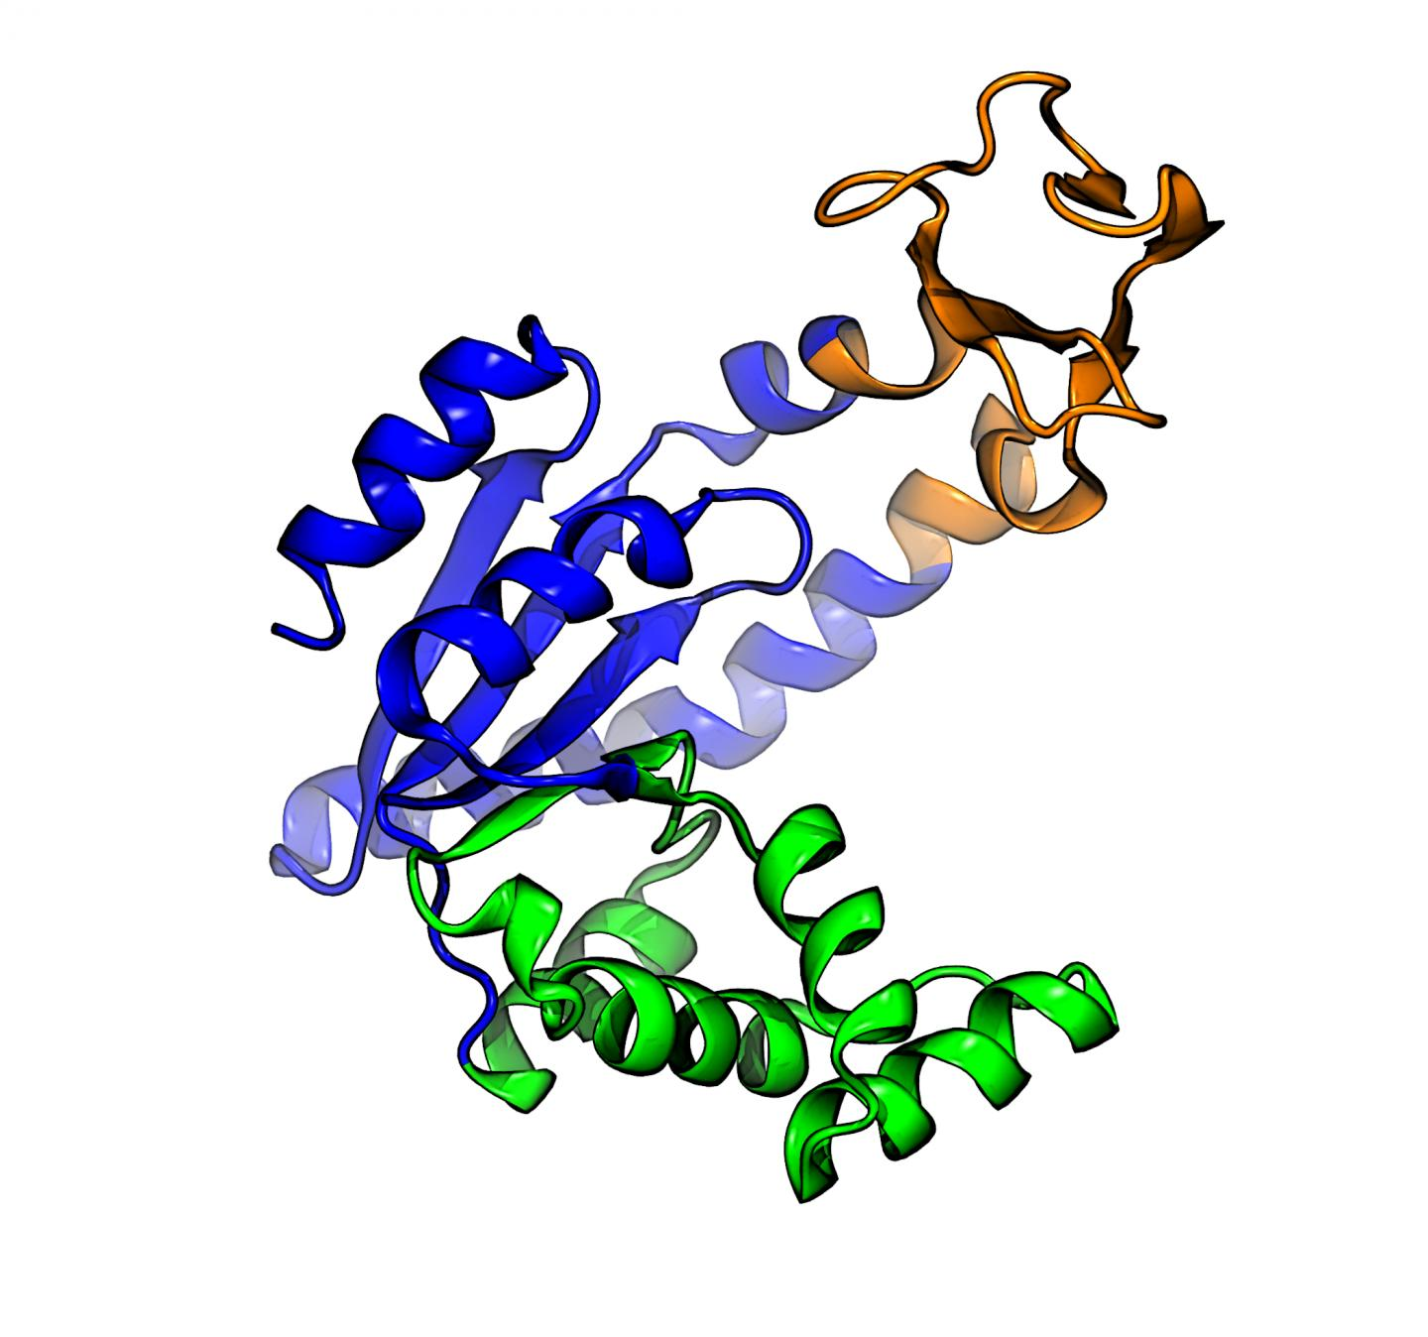
Networks and Machine Learning
Predict Protein Folding with Networks
Twenty amino acids:
ARNDCQEGHILKMFPSTWYV
If a protein has four amino acids ARND
 | A | R | N | D
A | - | 7 | 5 | 4
R | - | - | 2 | 1
N | - | - | - | 6
D | - | - | - | -
ARND

Slide 28
Misinformation vs. Cross-Cutting
A Network Measure for Cross-Cutting News Consumption
Policymakers want to promote citizens’ cross-cutting news consumption while at the same time reduce their exposure to misinformation.
However, in this paper, we show that more cross-cutting news consumption is associated with more misinformation exposure.

Slide 29
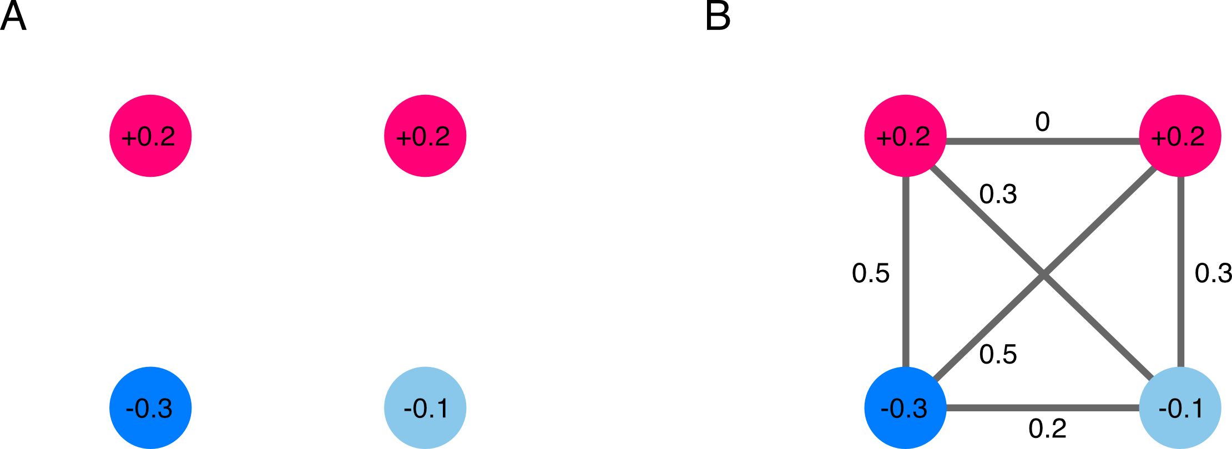
Misinformation vs. Cross-Cutting
A Network Measure for Cross-Cutting News Consumption
Characteristic path length as the average of path lengths of the connected network

Slide 30
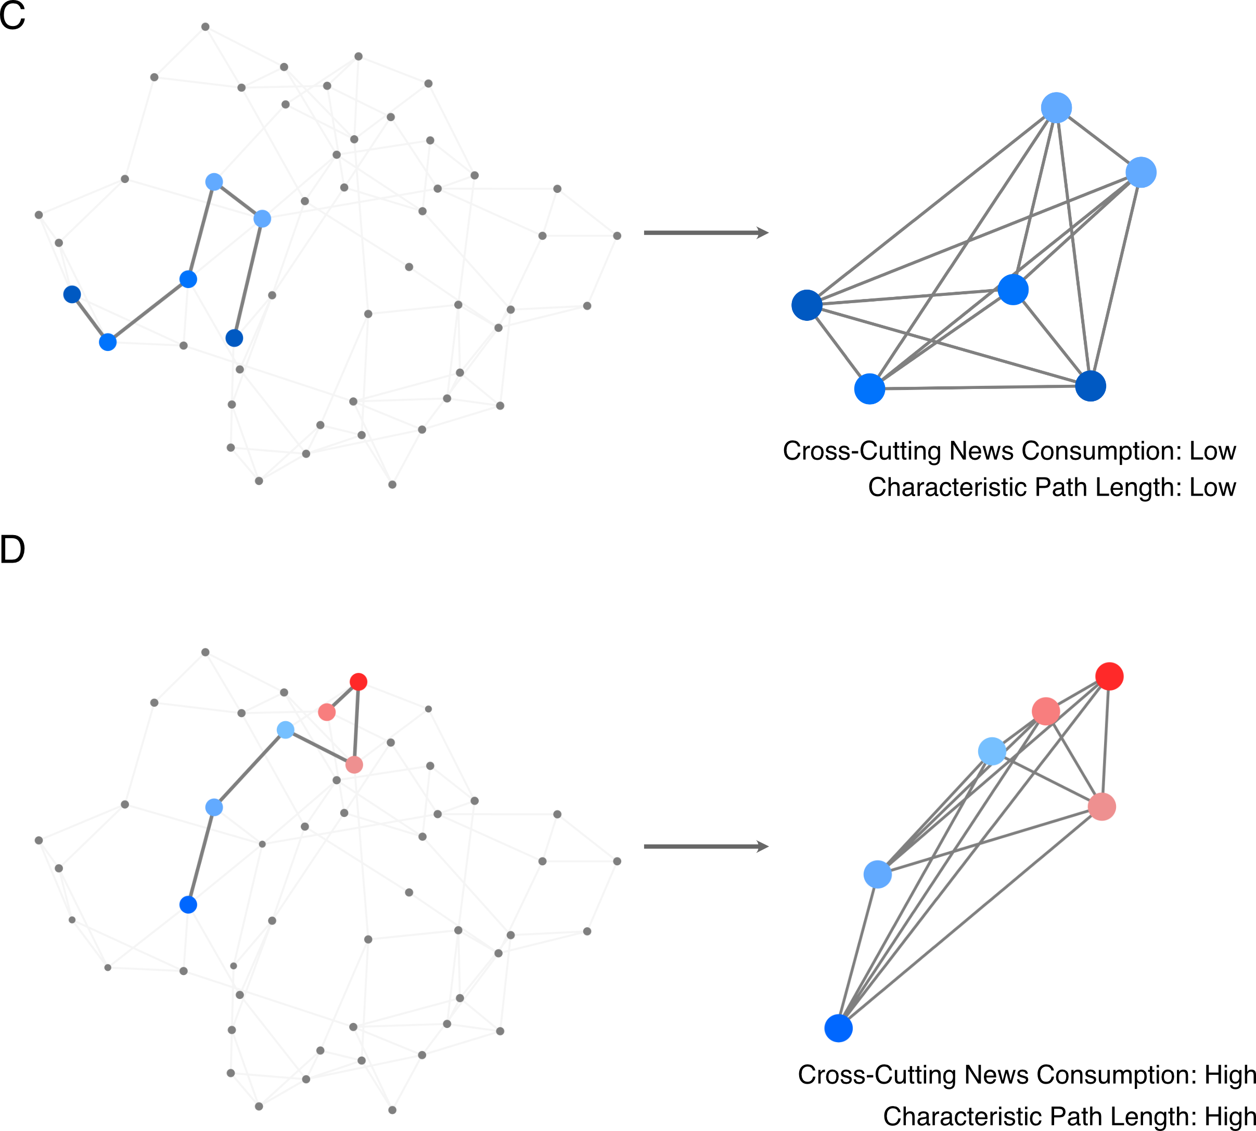

Slide 33
What predicts cross-cutting news consumption?
The new network measure as our dependent variable
Democrats have more diverse news diet.
Younger panelists have more diverse news diet.
Male panelists have more diverse news diet.
Black panelists and Hispanics have less diverse news diet (vs. White).
Panelists with higher education have more diverse news diet.
Panelists with higher income have less diverse news diet.

Slide 34
What predicts misinformation exposure?
NewsGuard <60 as misinformation, >60 as reliable news sources
Republicans have more misinformation exposure.
Panelists who read more news have more misinformation exposure.
Older panelists have more misinformation exposure.
Males have more misinformation exposure.
Black panelists and Hispanics have less misinformation exposure.
Panelists with higher income have less misinformation exposure.
Panelists that are unemployed have more misinformation exposure.

Slide 35
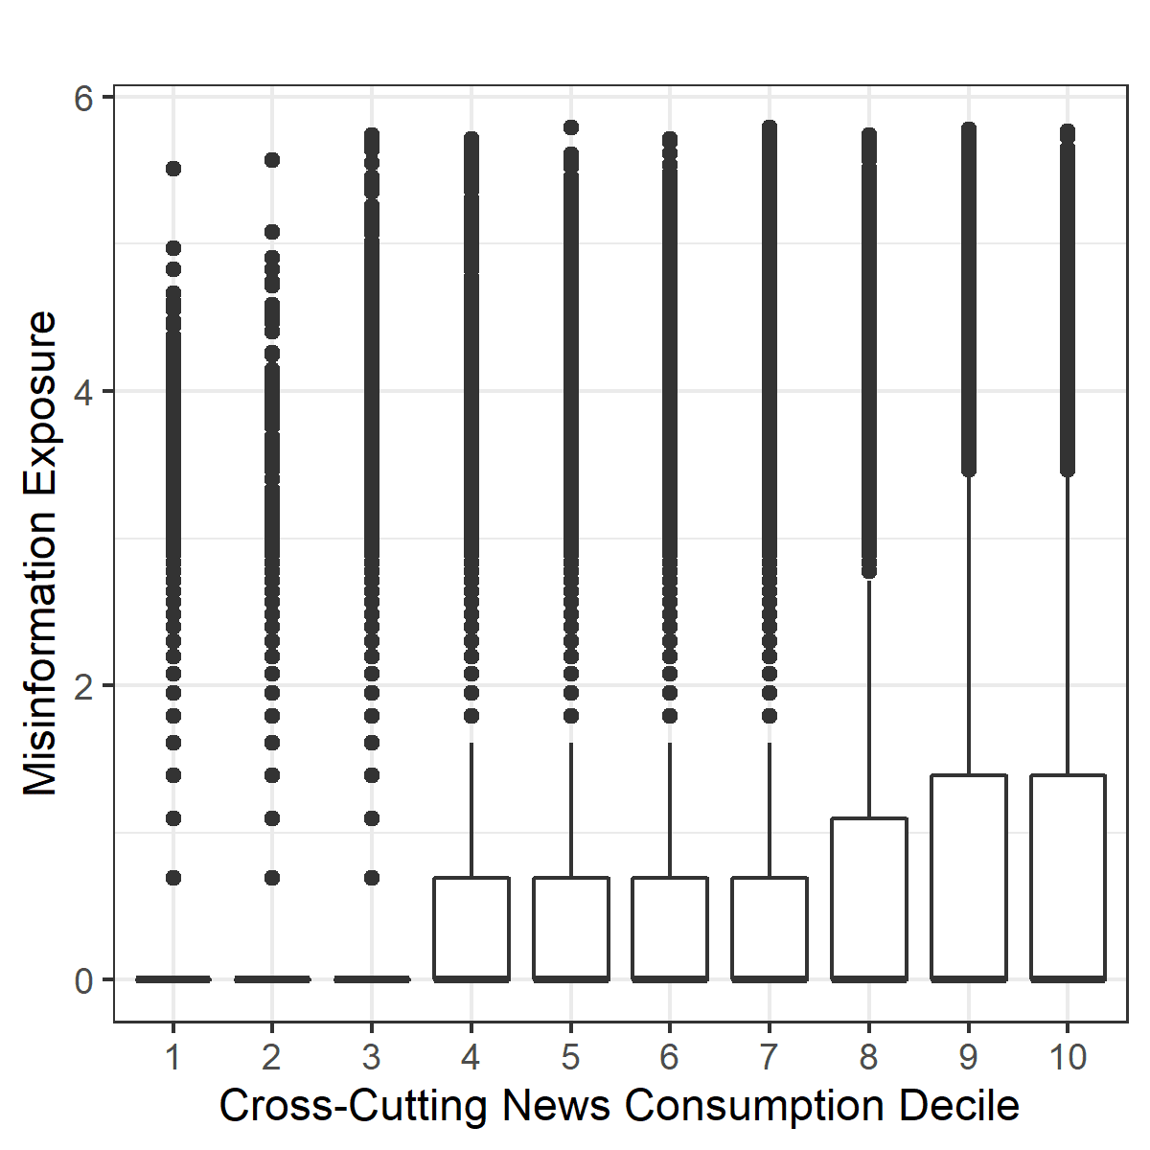
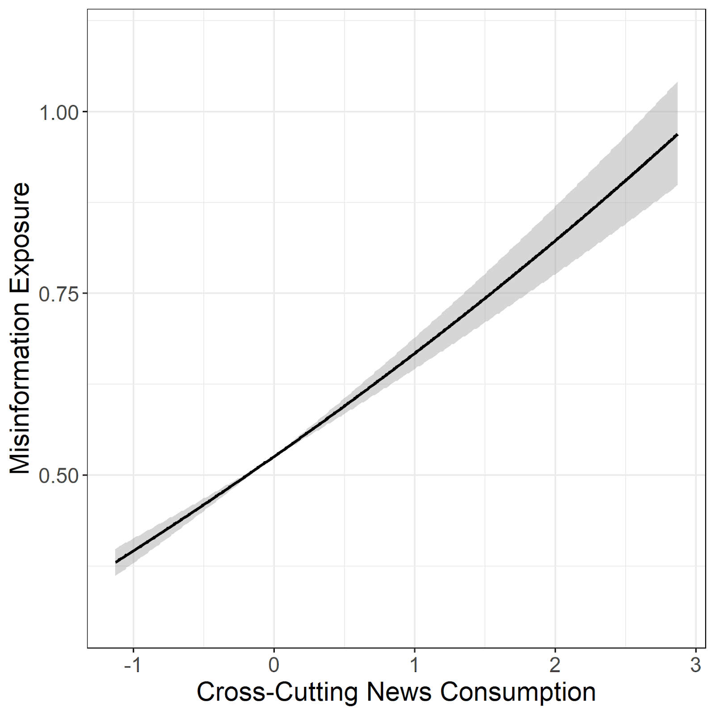
More cross-cutting means more misinformation
Between-subject, within-subject, robust for all five partisan groups

